Slide 1


Introduction to Water Chemistry & Hardness
Course Code: ETMLCH104
Course Name: Engineering Chemistry
Program: B.Tech. (AI/ML)
Unit 2: Chemical Fuels
Dr. Mehak Ahuja
Assistant Professor, Department of Chemistry
School of Basic and Applied Sciences
K.R. Mangalam University
Sohna Road, Gurugram

Slide 2

Course Overview
UNIT WISE DETAILS ​ ​ ​
Unit Number: 1 ​ | Title: Water technology ​ | No. of hours: 6 ​
Content Summary: ​ Introduction, water analysis: Hardness-determination by EDTA method, Treatment of boiler feed water: Internal treatment (Phosphate, Colloidal and Calgon conditioning). External treatments: Ion exchange and lime-soda process, Zeolite processes. Boiler scales formation and ill effects, methods of prevention of scales. Numerical problems ​
Unit Number: 2 ​ | Title: Chemical Fuels ​ | No. of hours: 9 ​
Content Summary: ​ Fuels: Introduction, classification, calorific value (HCV & LCV), Determination of calorific value of fuel using Bomb calorimeter. ​ Solid fuel: Coal- its analysis by proximate and ultimate analysis, Numerical problems. ​ Liquid fuels: Refining of petroleum, Petroleum cracking, Knocking in IC engine, its ill effects and prevention of knocking. Anti-knocking agent: Leaded and unleaded petrol. ​ Gaseous fuels: LPG, CNG and their applications. ​
Unit Number: 3 ​ | Title: Battery Technology ​ | No. of hours: 10 ​
Content Summary: ​ Introduction - Galvanic cell, electrode potential, EMF of the cell and cell representation. Batteries and their importance, Classification of batteries- primary, secondary and reserve batteries with examples. Battery characteristics - voltage, capacity, energy density, power density, energy efficiency, cycle life and shelf life. ​ Construction, working and applications of: Ni-Cd, and Lithium-ion battery. Working principle of an electric vehicle. ​
Unit Number: 4 ​ | Title: Polymer ​ | No. of hours: 5 ​
Content Summary: ​ Basic concepts of polymer, Types of polymers, Thermoplastic & thermosetting plastics, Preparation and application of some industrially important polymers (Natural rubber, Buna S, Buna-N, Neoprene, Isoprene, Nylon-6, nylon-6,6 , Decron and Terylene). Conducting and biodegradable polymers. ​

Slide 3
COURSE OUTCOMES
CO1: Understand the methods for water hardness and the basics of boiler water treatment and analyze fuel calorific values and battery.
CO2: Explain the characteristics and working principles of different battery types and types of fuels.
CO3: Determine the differences between batteries and fuel cells and classify fuel cell types based on their components..
CO4: Identify between hard and soft water, solve the related numerical problems on water purification and emf and its significance in industry and daily life.

Slide 4

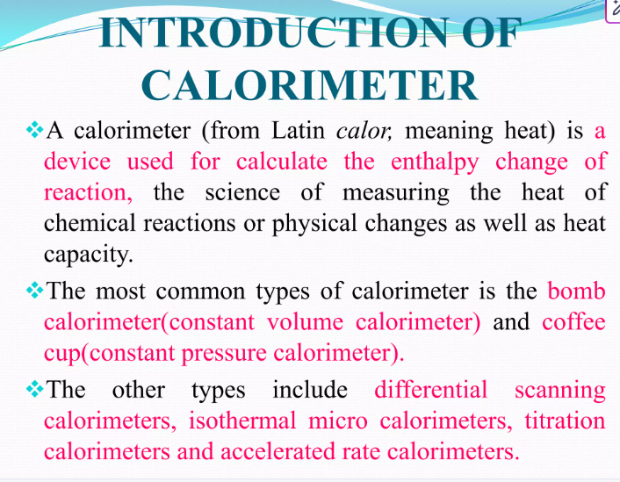


Slide 5
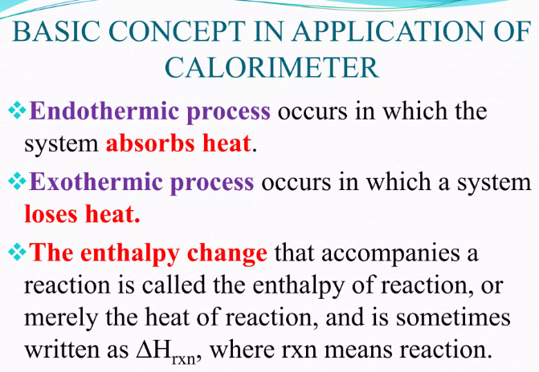

Slide 6
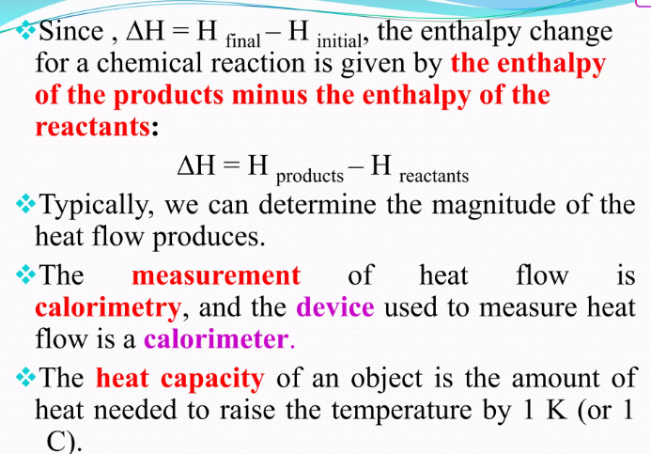

Slide 7
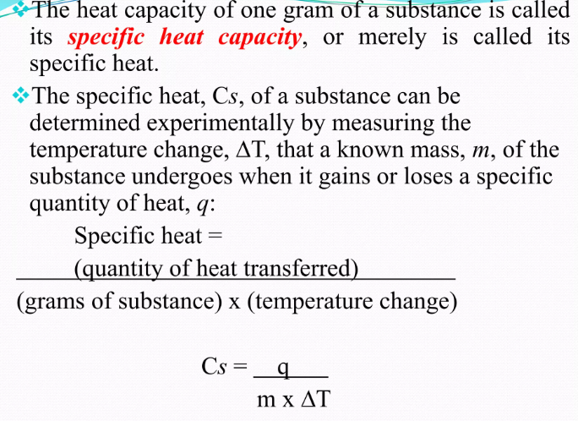

Slide 8
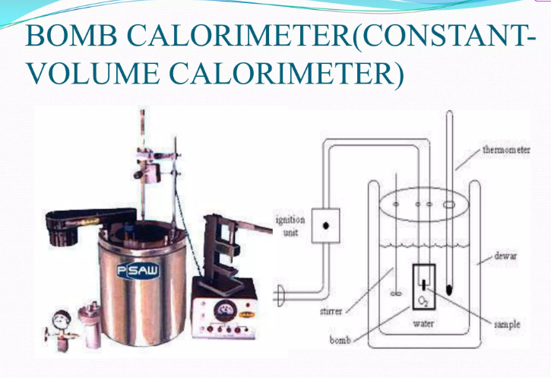

Slide 9
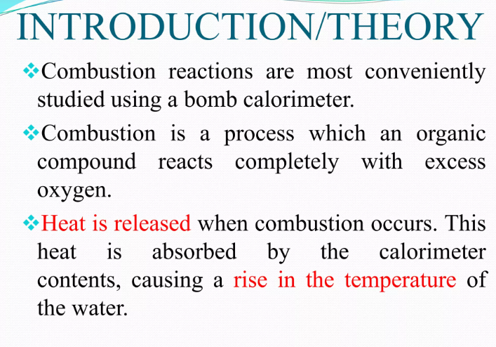
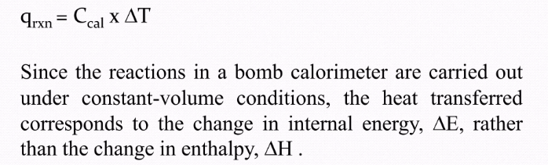

Slide 10

Determination of calorific value of fuel using Bomb calorimeter
Bomb Calorimeter: Construction & Working

Slide 11
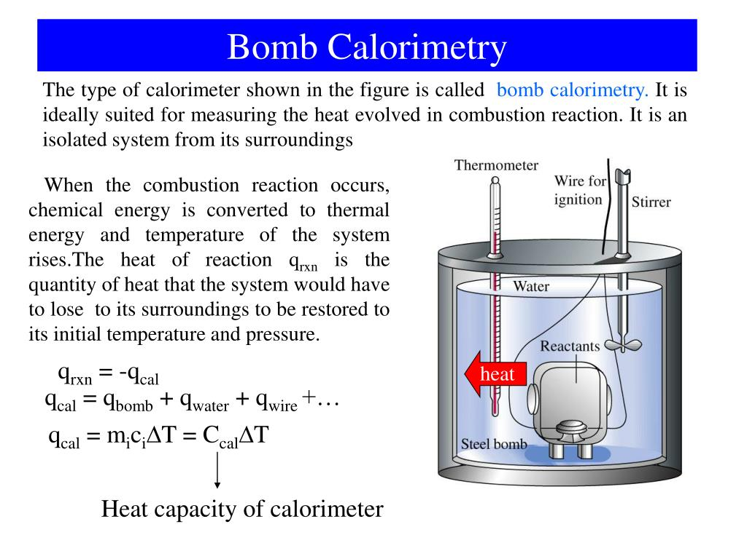

Slide 12
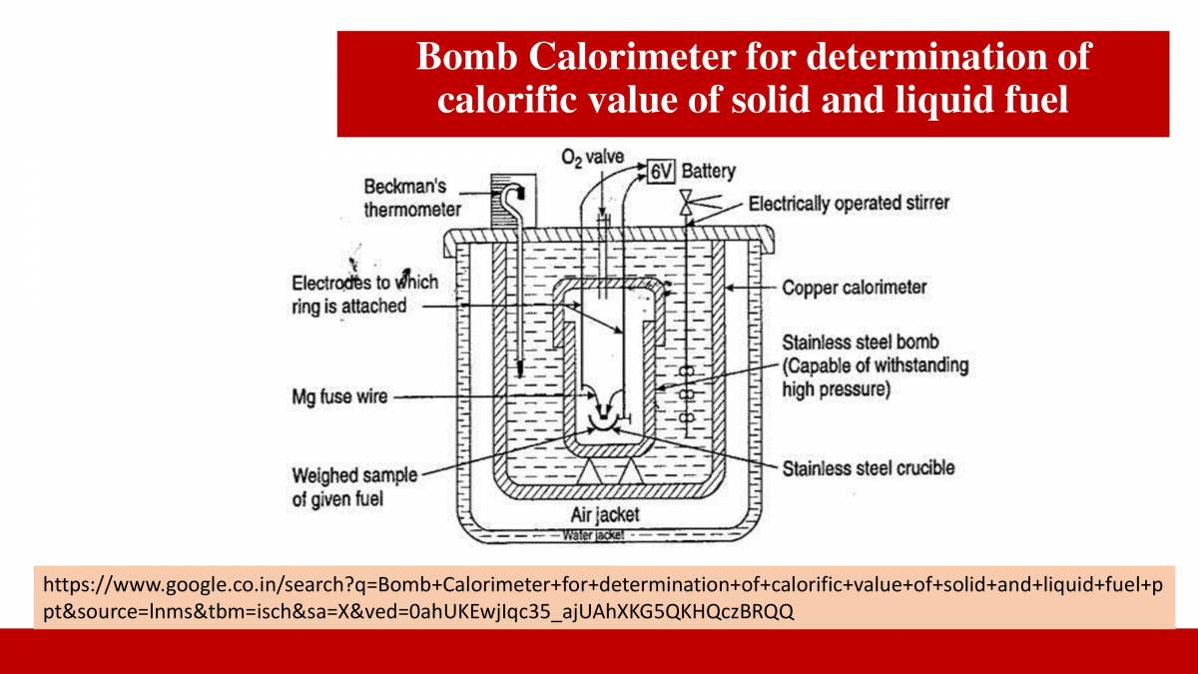
Bomb Calorimeter

Slide 13
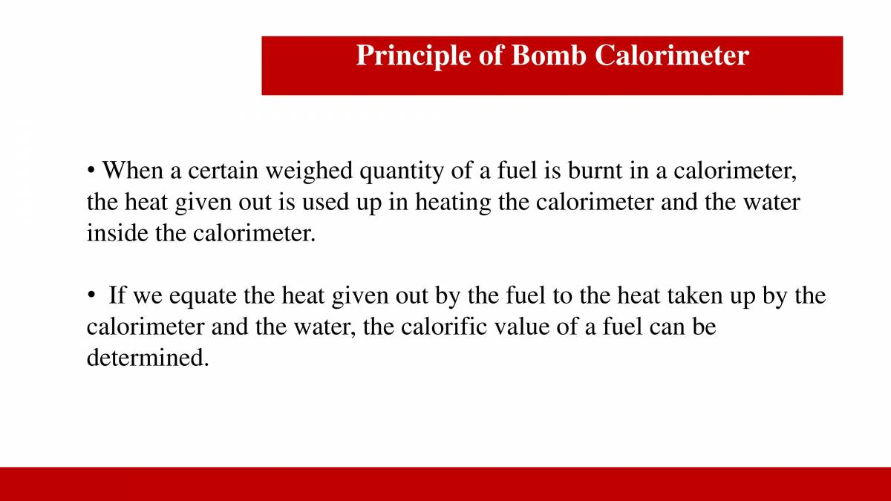
Principle of Bomb Calorimeter

Slide 14
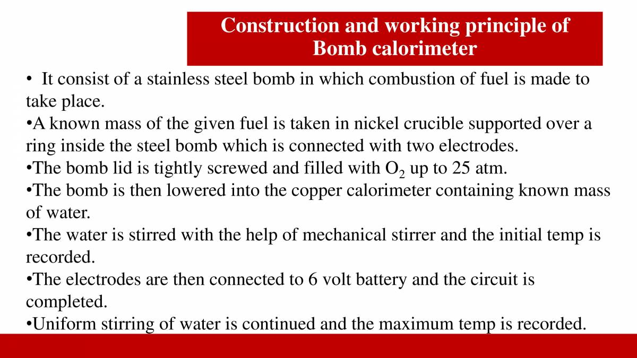
Construction and working of Bomb Calorimeter

Slide 15
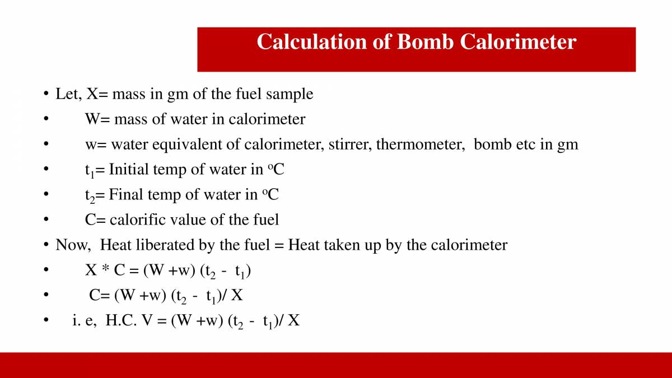
Calculations of CV of Bomb Calorimeter

Slide 16
Corrections for Calculations of CV of Bomb Calorimeter
Fuse wire corrections: The measured heat includes the heat given out by ignition of fuse wire used.
Acid correction (Ca): Under high pressure and temperature of ignition, N and S present in fuels are oxidized into HNO3 and H2SO4. In the exothermic reactions the heat thus liberated is not obtained by the use of fuel so the correction must be made for the heat liberated in the bomb by the formation of acids H2SO4 and HNO3.
S + O2 gives SO2
2SO2+ O2+ 2H2O 2H2SO4 + heat
2N2+ 2H2+ 3O2 2HNO3 + heat

Slide 17
Corrections for Calculations of CV of Bomb Calorimeter
Cotton thread correction: Cotton thread correction is made by the mass of the dry cotton thread used for firing which is added into acid and fuse wire correction.
Cooling correction : The rate and time taken for cooling of water in calorimeter from maximum temp. attained to the room temp. is noted. If the rate of cooling is degree per minute and the actual time taken for cooling is x then cooling correction = x Xdt, must be added to the rise in temperature(t2-t1).
HCV = (W + w)(t2-t1+Cooling factor)-(Fuse wire corr. + Cotton thread corr. + Acid corr.)/mass of fuel
unit : kcal/kg or cal/g

Slide 18
Practice Numericals
A sample of coal contains: C = 83%, H = 6% and ash 1%. The following data were obtained when the above coal was tested in a bomb calorimeter: Weight of coal burnt = 0.92 g Weight of water taken = 550 g Water equivalent of calorimeter = 2,200 g Rise in temperature = 2.42ºC Fuse wire correction = 10.0 cal Acid correction = 50.0 cal Calculate the gross and net calorific values of coal, assuming that the latent heat of condensation of steam is 580 cal/g.
Weight of coal sample (x) = 0.92 g, Weight of water (W) = 550 g
Water equivalent of calorimeter = 2200 g
Rise in temperature (T2-T1) = 2.42 ºC
Fuse wire correction = 10.0 cal, Acid correction = 50.0 cal
Latent heat of steam = 580 cal/g
% of H = 6 %
HCV = (550 + 2200) × 2.42 / 0.92 = 7,168.5 cal/g
N.C.V. = (G.C.V. – 0.09 H × latent heat of steam = (7,168.5 – 0.09 × 6 × 580) cal/g = 6,855.3 cal/g

Slide 19
In an experiment in a Bomb calorimeter, a solid fuel of 0.90 g is burnt. It is observed that increase of temperature is 3.8ºC of 4000 g of water. The fuel contains 1% of H. calculate the HCV and LCV value (equivalent weight of water = 385 g and latent heat of steam = 587 cal/g).
Sol: Weight of fuel (x) = 0.90 g
Weight of water (W) = 4000 g
Equivalent weight of water (w) = 385 g
Rise in temperature (T2-T1) = 3.8ºC
Percentage of carbon = 1%, Latent heat of steam = 587 cal/g HCV = (W + w) (T2- T1) ÷ w cal/g = (4000 + 385) (3.8) ÷ 0.90 cal/g = 18514.5 cal/g
LCV = (HCV – 0.09 H × 587) = 18514.5 – 0.09 × 1 × 587 = 18461.6 cal/g

Slide 20
Take away of the session
Purpose: Used to accurately determine the calorific value of a solid or liquid fuel.
Principle: A known mass of fuel is burnt in excess oxygen inside a strong steel bomb, surrounded by water.
Measurement: The rise in water temperature is measured to calculate the heat released.
Key Components: Bomb, ignition wire, oxygen supply, water jacket, thermometer, and stirrer.
Formula Used:
Gross Calorific Value (HCV)=(W+w)(T2−T1)+Ccm\text{Gross Calorific Value (HCV)} = \frac{(W + w)(T_2 - T_1) + C_c}{m}Gross Calorific Value (HCV)=m(W+w)(T2 −T1 )+Cc
Where:
WWW = mass of water
www = water equivalent of calorimeter
T2−T1T_2 - T_1T2 −T1 = temperature rise
CcC_cCc = correction for fuse wire, cotton thread, etc.
mmm = mass of fuel burned

Slide 21
Questions
1. What is the main function of a bomb calorimeter? A. Measure fuel density B. Determine calorific value C. Test fuel viscosity D. Measure pH of fuel ✅ Answer: B
2. What surrounds the bomb in a bomb calorimeter? A. Mercury B. Alcohol C. Water D. Sand ✅ Answer: C
3. What is used to initiate combustion in the bomb calorimeter? A. Magnesium strip B. Matchstick C. Electric ignition wire D. Laser ✅ Answer: C
4. The calorific value obtained using a bomb calorimeter is usually: A. LCV (Lower Calorific Value) B. HCV (Higher Calorific Value) C. Average Calorific Value D. Theoretical Calorific Value ✅ Answer: B
5. Why is oxygen used in the bomb calorimeter? A. To maintain pressure B. To prevent rusting C. To ensure complete combustion D. To cool the system ✅ Answer: C

Slide 22
Learning Outcomes
BTL-1: Recall definitions and types of fuels (CO2)
BTL-2: Explain characteristics of solid, liquid, and gaseous fuels;
define calorific value (CO1, CO2)
BTL-3: Apply knowledge to identify ideal fuels and solve questions
related to fuel properties (CO1, CO2)
CO1: Understand the methods for water hardness and the basics of boiler water treatment and analyze fuel calorific values and battery.
CO2: Explain the characteristics and working principles of different battery types and types of fuels.
Mapped Course Outcomes

Slide 23
References
Engineering Chemistry by Jain and Jain.

